Slide 1
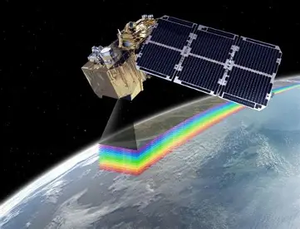
Web-Based
Satellite-Observed Mountain Snow-Cover Visualization Tool
University of Idaho Capstone Project
2026-27
Sponsor: Dr. Russell Qualls, BE
rqualls@uidaho.edu

Slide 2
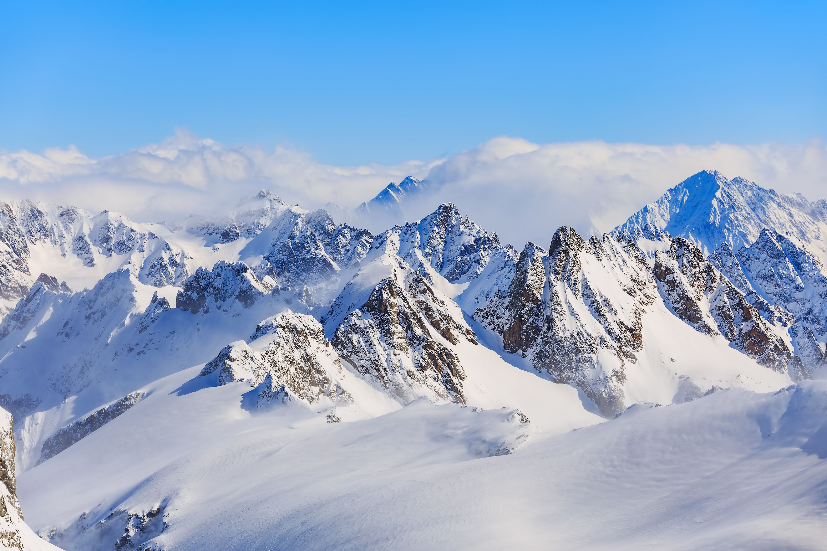
Project Importance
Idaho Agriculture: 10’s of billions of dollars annually
>75% Water Supply from mountain snowpack → Irrigation
Snow affects water supply/drought
Satellite Snow Cover/Clouds
Project Identifies Progression of Mou ntain Snowmelt through Spring Snowmelt Period
Many Interested End-Users:
  NASA
  SNOTEL (NRCS Snow Telemetry Stations)
  Idaho Department of Water Resources (drought assessment; water management)
  Idaho Office of Emergency Management (Drought assessment and mitigation)
  US Army Corps of Engineers (reservoir operations)
  Idaho Power (reservoir operations)
  Pacific Northwest Drought Early Warning System Committee (PNW DEWS)

Slide 3
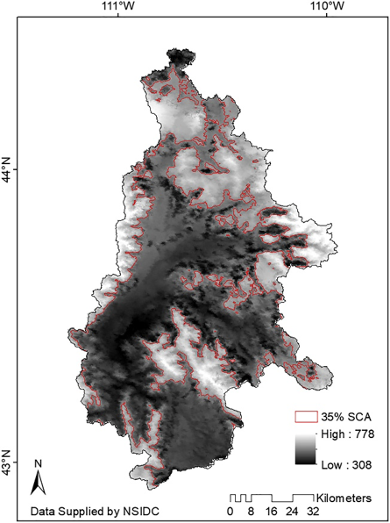
Scope: Develop a web-based visualization tool to retrieve remotely sensed satellite snow cover data and calculate and display the interannually recurring snowmelt pattern for user-selected mountainous watersheds in Idaho.
Figure 1. Example of the Interannually-recurring snowmelt pattern generated for the Snake River Headwaters. Darker colors indicate earlier melt, and lighter colors indicate later melt during the spring snowmelt period (Woodruff & Qualls, 2019).

Slide 4
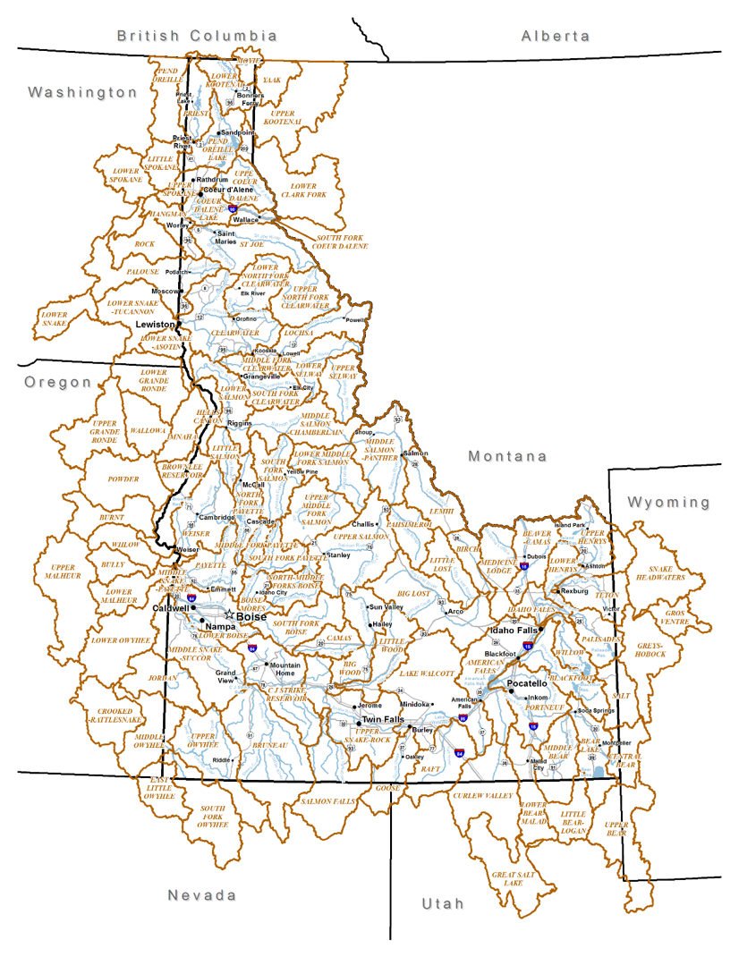
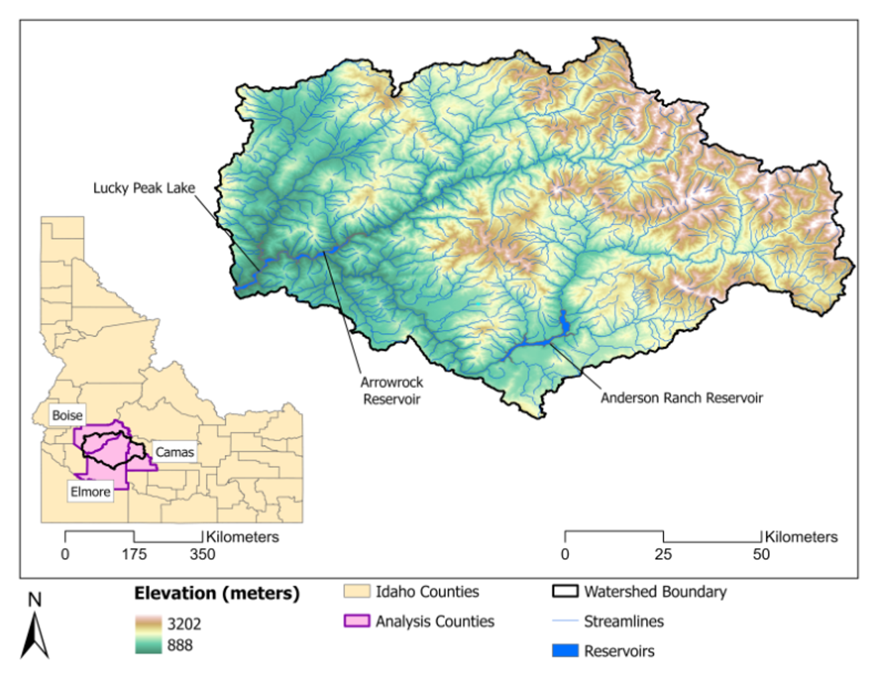
Idaho Watershed Boundaries
Watershed Example: Boise River Basin

Slide 5
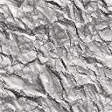

Web Tool Workflow
Interannual Melt Pattern (Sequence of Melt)
Seasonal Day of Melt (FDL), Year n
Daily Snow Cover
with Clouds, Year n
Daily Snow Cover without Clouds, Year n

Slide 6
Web Tool
User Options
Automated Processing
Automated Processing:
Data Procurement (NSIDC)
Watershed Coverage
Data Processing
Image Display
Data Storage/retrieval
User Options:
Watershed Selection
Satellite Sensor (MODIS, VIIRS)
Time Period

